Slide 1

Descriptive Business Analysis
Team 4
Notes:
Hello Everyone, thank you for being here.
I am excited to present y'all our Kimray Descriptive Business Analysis

Slide 2
Table of Content
1
Overview
1
2
Business Problem
2
3
Data Description
3
4
Cleaning
4
5
Analysis
5
Notes:
The table of content for today will be:
1. overview
2. business problem
3. data description
4. Cleaning
5. Analysis

Slide 3




Team Introduction
Noah Heinrich
Kalyan Alisetty
Sahil Gandhi
Anirud Vem
Overview
Business
Data
Cleaning
Analysis
Notes:
Team introduction
1. Noah
2. Kalyan
3. Sahil
4. Anirud

Slide 4
About Company
Founded 1945
Revolutionized
Brand
01
01
02
03
04
Location
Product
Business
Overview
Data
Cleaning
Analysis
Notes:
After building repour with our company representative Daniel Yunker and doing individual research we got a deep understanding about Kimray
It was 1945 Oklahoma City family owned start-up
Revolutionized oil & gas industry
Product was a three-inch pilot-operated back pressure regulator
Has grown to become a globally-known company

Slide 5
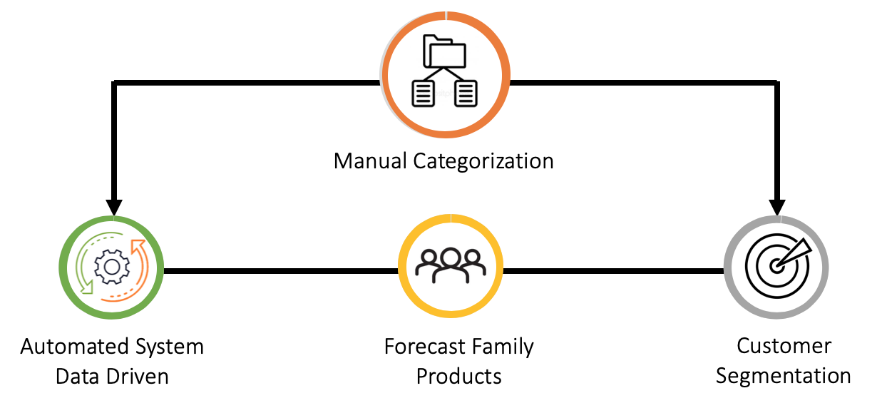
Business Problem
Rigorous Process
Product Categorization
Business
Overview
Data
Cleaning
Analysis
Notes:
We were able to locate the main business problem, which is the manual categorization system currently place.

Slide 6

Business Problem
Automated
Data Driven
Categorization
System
Business
Overview
Data
Cleaning
Analysis

Slide 7
Data
A
Components used
Bill of Materials
B
Number of components
A
Build material
Item Attributes
B
Product usage
A
Customer demographics
Sales Data
B
Order details
Data
Overview
Business
Cleaning
Analysis

Slide 8
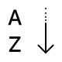



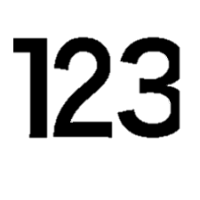
Data Cleaning
ITEM NUMBER
Item Type Description
Family Forecast
Forecast Family: Do not forecast
Item Class: Obsolete
Null
Cleaning
Overview
Business
Data
Analysis
Notes:
Removed 58% of data

Slide 9

Analysis

Slide 10
ABC Category
ABC Category | Quantity
A | 1473
B | 1773
C | 23447
ABC Category | Quantity Sold
A | 868K
B | 322k
C | 71.6k
ABC Category | Sale Amount
A | 104.2M
B | 44.8M
C | 27.1M
Total Products = 20408 || Total Components = 6285
Analysis
Overview
Data
Business
Cleaning
Notes:
Components of A products brings in just 5M sales, and 110 products brings in 99M sales.
Components of B products brings in just 6M sales, and 1400 products brings in 38M sales.
Components of C products brings in just 0.5M sales, and 19925 products brings in 26.5M sales.
Splitting of the 110 A:
Sale amount:
Aftermarket: 13.9M – (28 Products), Control valves/ PR/Temp Control – 85.1 M (82 Products)
Sale: 453K sales
Aftermarket: 222K , Control Valves/PR/Temp Control : 231K Sales
Splitting of the 373 B:
Sale amount:
Aftermarket: 10M (177 Products) Control valves/ PR/Temp Control – 28M (196 Products)
Sale: 153k total sales.
Aftermarket: 102K Control Valves/PR/Temp Control : 51K Salse

Slide 11
Item Type Description
Item Type Descr | Sales
Assembly/Sub | 618K
Purchased | 395K
Fabricated | 189K
Item Type Descr | Sale Amount
Assembly/Sub | 152.3M
Purchased | 14.3M
Fabricated | 8.5M
Analysis
Overview
Data
Business
Cleaning
Notes:
Assembly or Subassembly: Sellable products like control valves, pressure regulators, Aftermarket, liquid level controllers, pilots and accessories.
Purchased item: Purchased to use it as a component. Resell items are after market items.
Fabricated item: repair kits typically to support a bigger product.
Sales: Ass/SubAss – 618k , 395k, 189K
SaleAmnt: 152.3 M, 14.3M, 8.5M

Slide 12
Forecast Family
Forecast Family | Sale Quantity
Aftermarket | 935324
Control Valves | 89387
Pilots & Accessories | 65310
Liquid Level Controllers | 63397
Pressure Regulators | 51769
Temperature Controllers | 37143
Resell Items | 18537
Glycol Pumps | 1109
Forecast Family | Sale Amount
Control Valves | 62.8 M
Aftermarket | 37.9 M
Pressure Regulators | 25.0 M
Liquid Level Controllers | 24.3 M
Pilots & Accessories | 13.7 M
Resell Items | 4.8 M
Glycol Pumps | 4.7 M
Temperature Controllers | 2.8 M
Analysis
Overview
Data
Business
Cleaning
Notes:
All the items are divided into 8 forecast families based on the item functionality and further into 45 forecast sub families which give a more detailed information on the functionality of the item.
Pressure regulators –reduces the input pressure to a desired value at its output, are sub categorized into 0-124 PSI, 124-250 PSI and above 250 PSI
Control valves - control fluid flow by varying the size of the flow. are categorized based on the pressure they handle.

Slide 13
Forecast Family
Forecast Family | Sale Quantity
Aftermarket | 935324
Control Valves | 89387
Pilots & Accessories | 65310
Liquid Level Controllers | 63397
Pressure Regulators | 51769
Temperature Controllers | 37143
Resell Items | 18537
Glycol Pumps | 1109
Forecast Family | Sale Amount
Control Valves | 62.8 M
Aftermarket | 37.9 M
Pressure Regulators | 25.0 M
Liquid Level Controllers | 24.3 M
Pilots & Accessories | 13.7 M
Resell Items | 4.8 M
Glycol Pumps | 4.7 M
Temperature Controllers | 2.8 M
Analysis
Overview
Data
Business
Cleaning
Notes:
All the items are divided into 8 forecast families based on the item functionality and further into 45 forecast sub families which give a more detailed information on the functionality of the item.
Pressure regulators –reduces the input pressure to a desired value at its output, are sub categorized into 0-124 PSI, 124-250 PSI and above 250 PSI
Control valves - control fluid flow by varying the size of the flow. are categorized based on the pressure they handle.

Slide 14


Sales in Last 12 Months
In top 50 products sold, 40 are After Market Products.
Ex: RDG, T2899, EBY
Top products excluding After Market,
Ex: AAR, EFU, EFG, ECP
Item Number | Category | Item Type | Quantity Sold | Sale Amount
AAR | A | Pressure Regulators | 18461 | 6.7 M
EFU | A | Control Valves | 1818 | 5.1 M
EFG | A | Control Valves | 3144 | 3.8 M
ECP | A | Control Valves | 6260 | 3.5 M
Analysis
Overview
Data
Business
Cleaning

Slide 15
Unit Cost > Base Price
Analysis
Overview
Data
Business
Cleaning

Slide 16
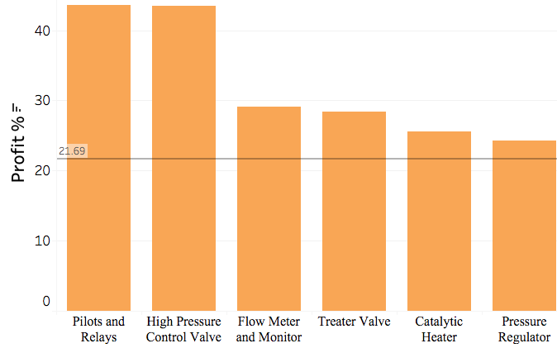
Profit % of Top Performing Products
Analysis
Overview
Data
Business
Cleaning

Slide 17
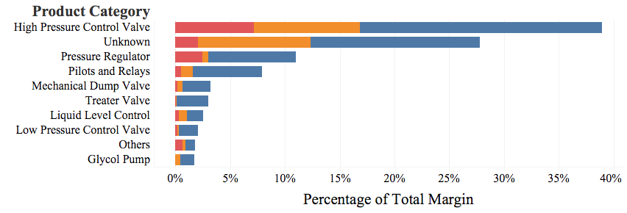
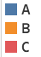
Total Margin % (Product Category)
Analysis
Overview
Data
Business
Cleaning

Slide 18
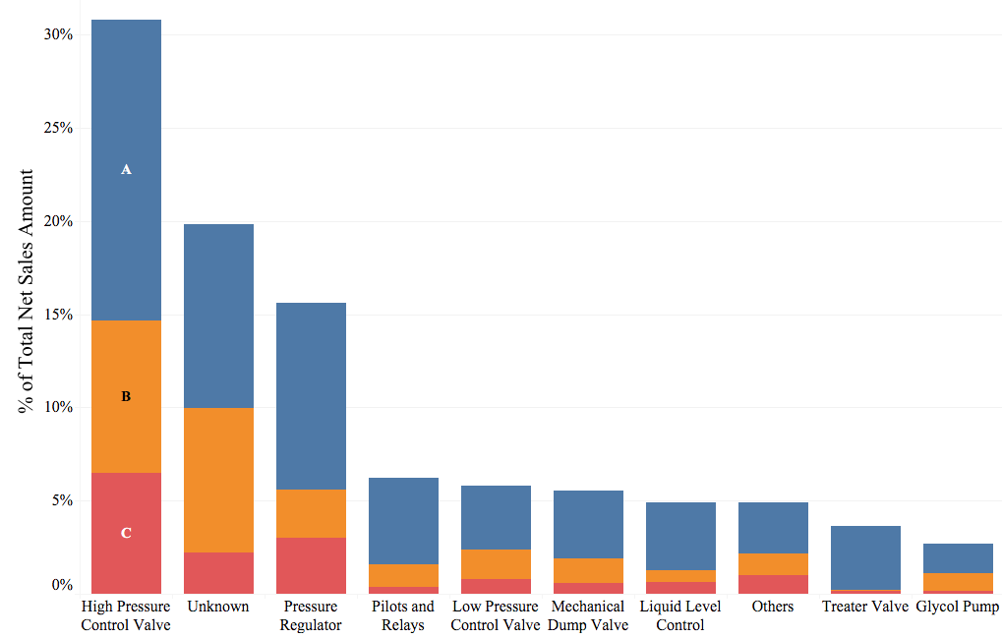
Net Sales (Product Category)
Net Sales Amount (Last 12 Months):
176.3 Million $
Analysis
Overview
Data
Business
Cleaning

Slide 19
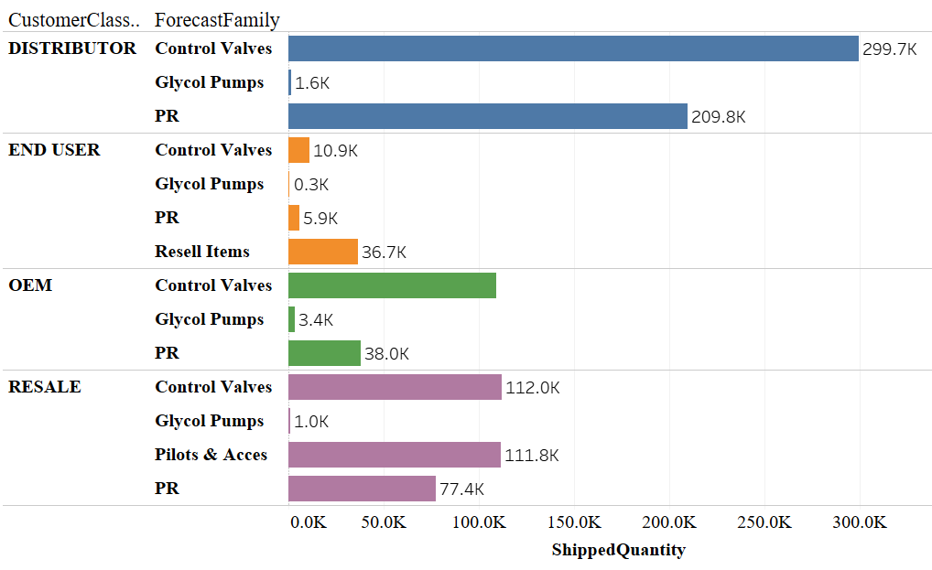
Products ordered by Customer Class
Highest : Customers
- DNow
Highest : Distributor
- Control Equipment, Inc
Lowest : Export Distributor
Analysis
Overview
Data
Business
Cleaning

Slide 20
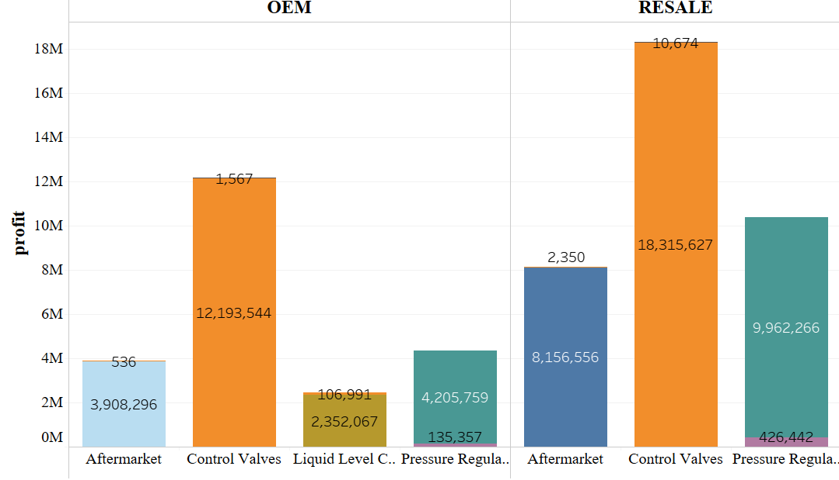
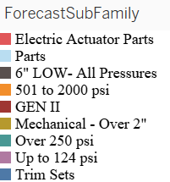
Profits from Primary Customers
Highest : Resale(121.42M), OEM(73.45M)
Analysis
Overview
Data
Business
Cleaning

Slide 21
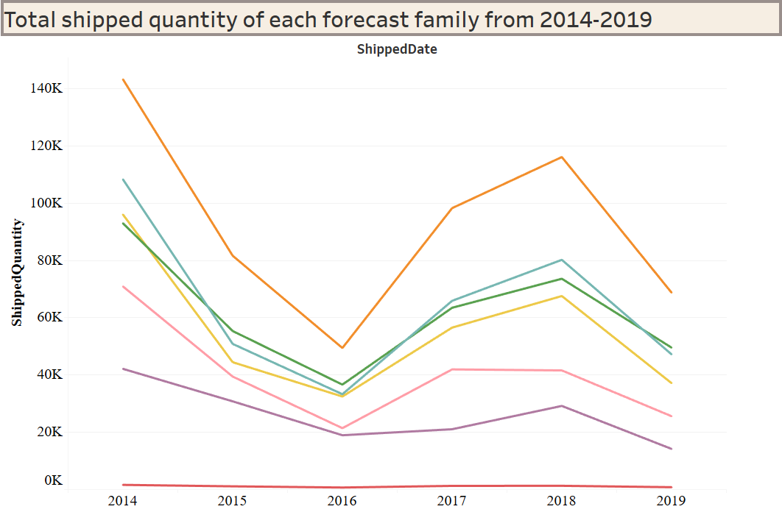
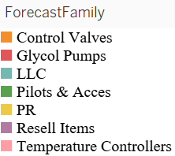
Quantity of products ordered over years
2014-2016
2016-2018
After Spring: Profit increased except for 2019
After Summer: Profit declined except for 2017
Analysis
Overview
Data
Business
Cleaning
Notes:
This is trends lines for different forecast families about the amount of quantity shipped. As the aftermarket products are the majority products ordered which is about 73% from all the states through all the years and which are very large in quantity so we have separated them from our analysis. The products ordered from all the categories has went down from 2014 to 2016 which may be probably due to the oil crisis and drop in the oil prices through 70% during the 2014- 2016 was one of the biggest declines after worldwar 2. and there is again some decrease from 2018 to 2019 as the oil prices started dropping again during to the competition from the other markets international and proportion of US exports on O&G equipment would be decreasing in the next few years as Ishares Us Aerospace & Defense (ITA) projections . And majority of the orders are of control valves and later is the pilot & Accessories, LLC and glycol pumps seems to have almost constant quantity of products ordered over years may be because the kimray is not good at producing it

Slide 22
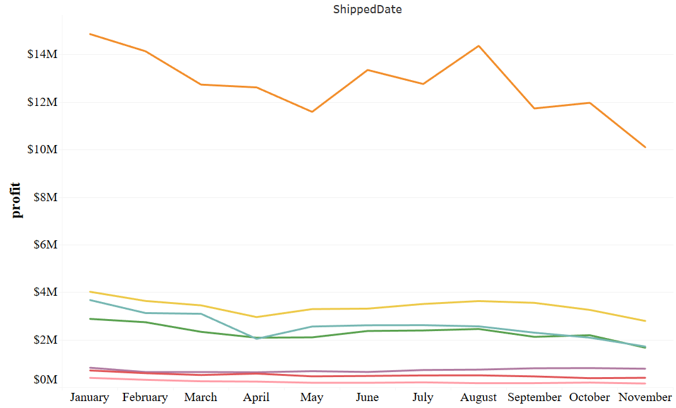
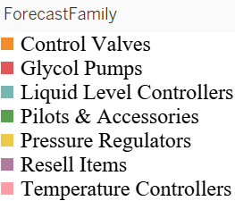
Avg Profit over different month per category
Profit is more from control valves
Analysis
Overview
Data
Business
Cleaning
Notes:
Even though after market products are ordered the most but the profit from them is less than the control valves.
Even though there is large increase in the quantity shipped of pilot& accessories, PR, LLC the profit increased only less amount after April. This may be because of the increase in the operating costs, and the shipping expenses which can improved by analysing them by different states and establishing new manufacturing units near to every corner of the country which can reduce shipping cost

Slide 23
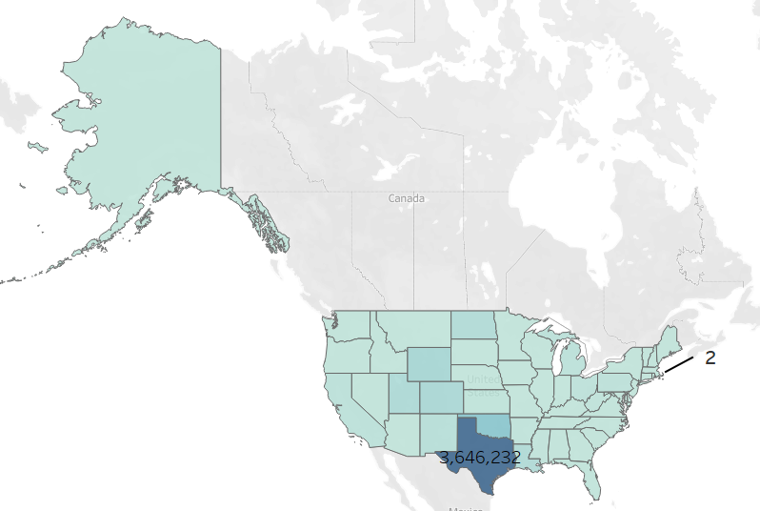
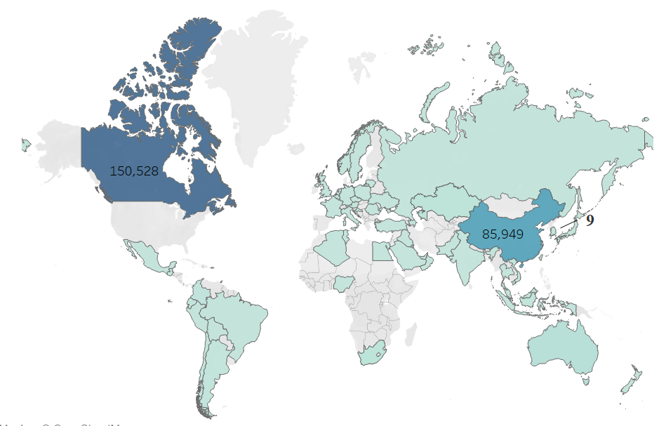
Quantity ordered from each state
Highest : Texas
- Control Equipment, Inc.
Lowest : Rhode Island
- Waukesha-Pearce IND, Cash Sale #1
Highest : Canada
- Wika Instruction, LP
Lowest : South Korea
- Export Prepay Account
Analysis
Overview
Data
Business
Cleaning
Notes:
As you see the majority of the orders are from the Texas and Oklahoma because the company is located at only these places.
And the least number of the orders are from the Rhode Island
We can improve the marketing in the states like Pennsylvania ,Iowa, North Dakota, South Dakota as these states has been showing steady increase in the revenue from the past 4 years. Out of which south Dakota has been showing an increased profits from the past 4 years.
The countries like Russia, United Kingdom has been showing an increasing revenue from the past 3 years which can be improved more marketing.

Slide 24
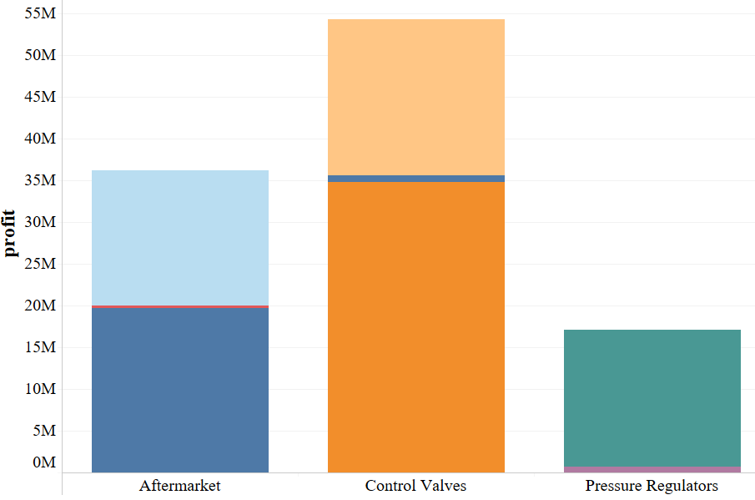
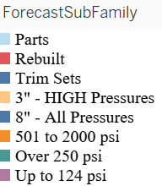
Profits per category in TX
Control Valves = $85.47M
After Market = $42.75M
Pressure Reg = $20.91M
Highest : Odessa($49.08M)
Lowest : Van(-$283)
Analysis
Overview
Data
Business
Cleaning
Notes:
53.5% profits from TX
PR- 11.23%(5.4% ordered quantity)
CV – 45.88%(7.8% ordered quantity)
AM – 22.95%(71% ordered quantity)
The two CV’s contributed about 63%(70% of ordered) of total cv
Lowest in CV is about 1%
The one PR contribute to about 78.46%(83.66% of ordered) of total PR’s
Lowest PR is accounting for 3.2%

Slide 25
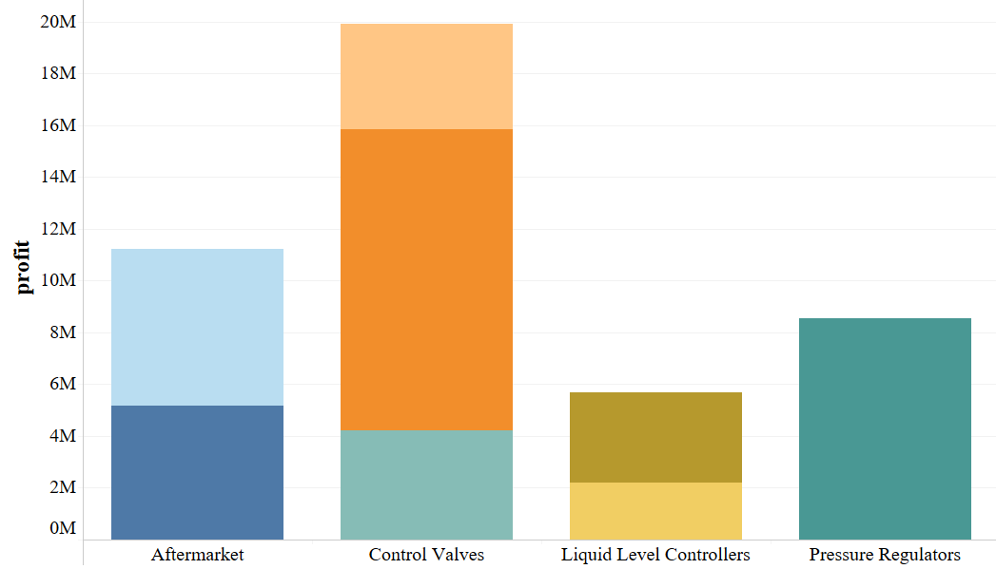
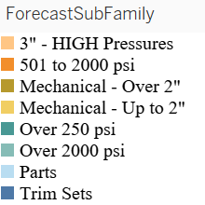
Profits per category in OK
Control Valves = $24.48M
Pressure Reg = $10.09M
After Market = $13.02M
LLC = $11.15M
Analysis
Overview
Data
Business
Cleaning
Notes:
OKC is contributing to about 18.77 percent of products.
CV- 36.9% of total from OKC
PR- 15.21%
LLC – 16.82%
AM – 19.63%
Each of the products in each category are about more than 70% of the contribution

Slide 26
Further Analysis
Descriptive statistics have provided insights on the products. Based on the insight's products need to be categorized into similar clusters based on the similar attributes.
Based on analysis on the customers, we would be segmenting the customer based on the demographics and sales.
Analysis to suggest the products which are bought together by the customers.
Analysis
Overview
Data
Business
Cleaning

Slide 27
Thank You
Questions?

Slide 28
Apendix

Slide 29
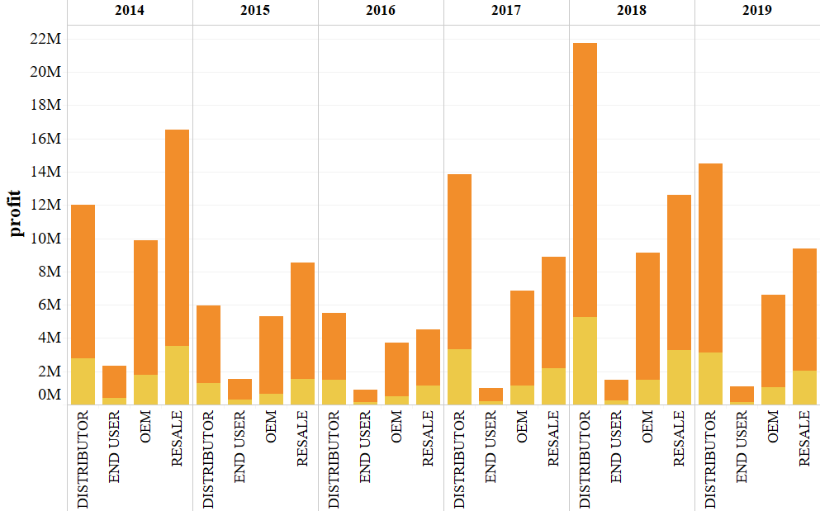
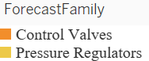
Profit from major products over years
Analysis
Overview
Data
Business
Cleaning

Slide 30
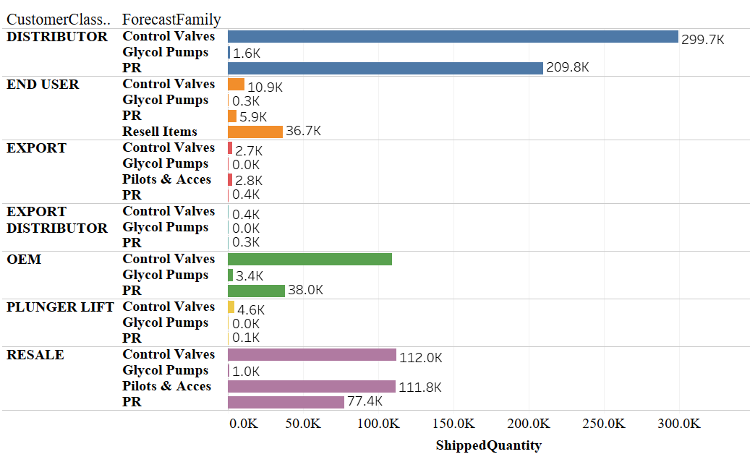
Products ordered by customers
Highest : Customers
- DistributionNOW
Highest : Distributor
- Control Equipment, Inc
Lowest : Export Distributor
Analysis
Overview
Data
Business
Cleaning

Slide 31
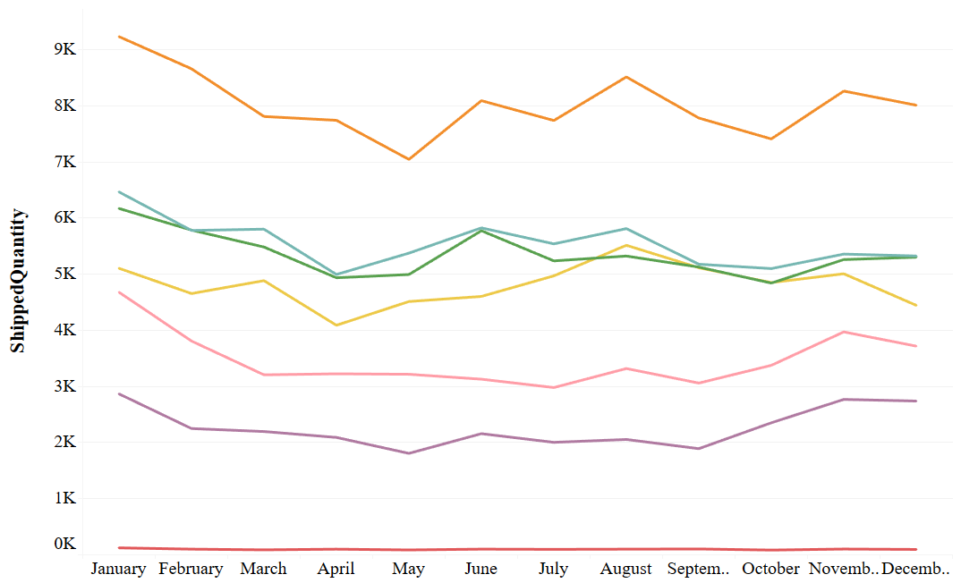
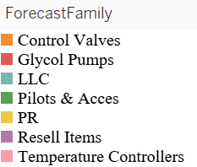
Average Products ordered each month
Jan – Apr or May
May - Aug
Aug - Dec
Analysis
Overview
Data
Business
Cleaning
Notes:
The average products ordered per each month during an year is varying for different type of products. After market & Control values have been ordered more compared to all other items. We have removed aftermarket products from our analysis. This can be helpful to forecast the monthly items that can ordered in month of a year. As you see the number of products ordered increasing in the summer as the requirement of gas is increasing

Slide 32
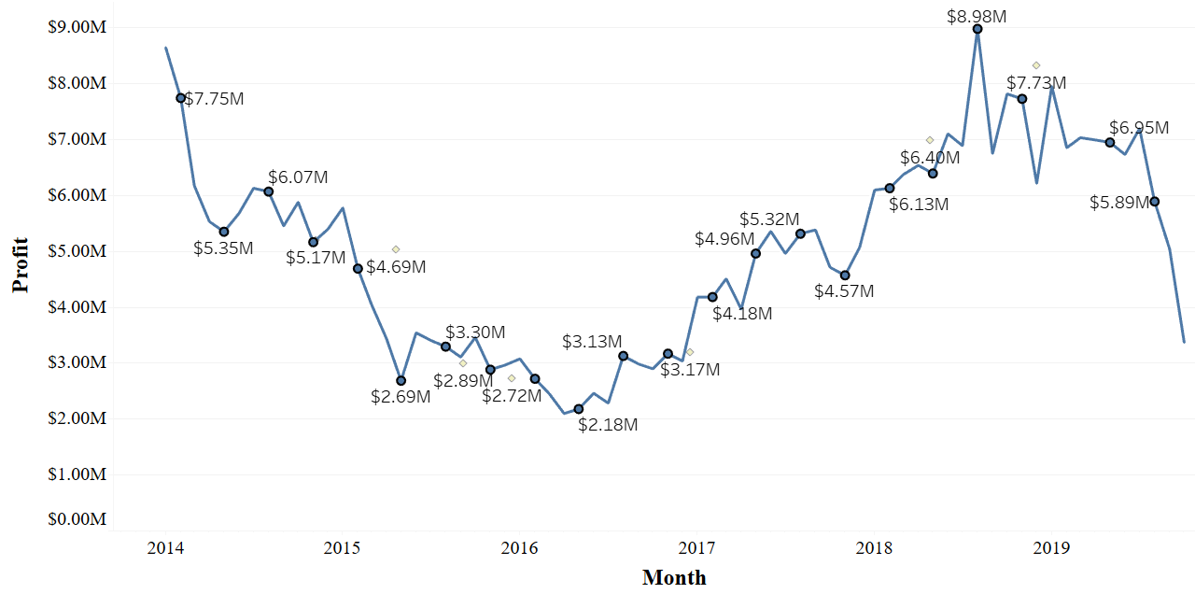
Profit per year
After Spring: Profit increased except for 2019
After Summer: Profit declined except for 2017
Analysis
Overview
Data
Business
Cleaning
Notes:
This shows the profit earned by the company in each month over the years. The marked or the labelled point shown are the seasonal change point. We have observed that profit has increased after every spring except in 2018 as after spring there will be an increase in gas consumption in summer due to high electricity requirement. And also it has declined after summer except for 2017 which is also only a slight increase.

Slide 33
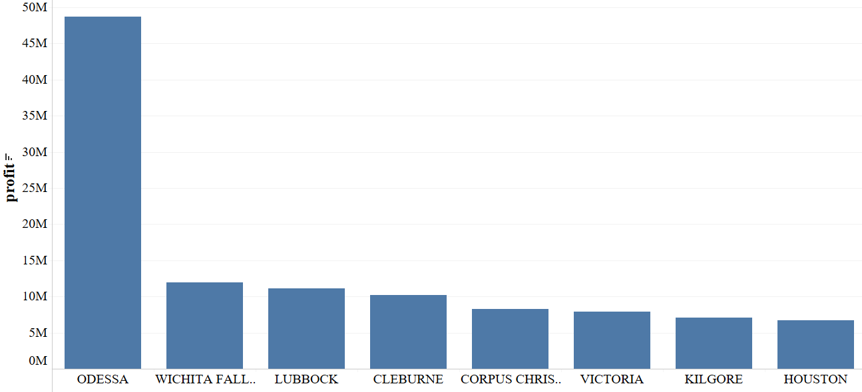
Major profits from a city in TX
Highest : Odessa(49.08M)
Lowest : Van(-283)
Analysis
Overview
Data
Business
Cleaning
Notes:
Odessa contribute to about the 26% of the total from Texas.

Slide 34
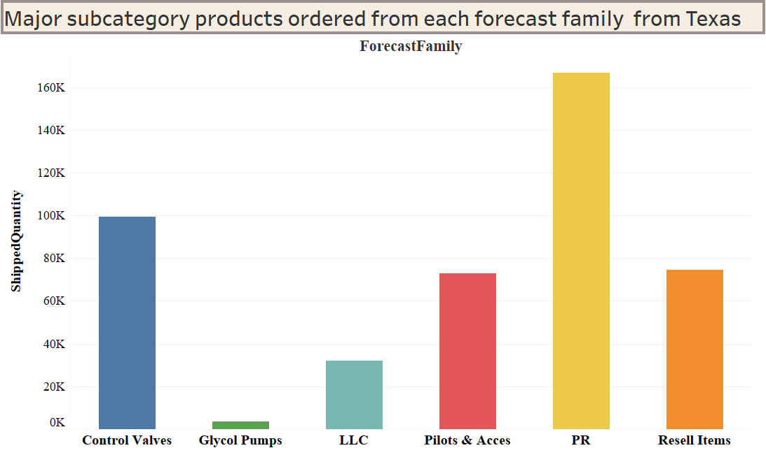
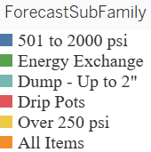
Quantity ordered Texas
Excluded Aftermarket
After Market – 2596.466K(71.2%)
Glycol Pumps – 3.85K
Analysis
Overview
Data
Business
Cleaning
Notes:
Now moving onto the Texas, which is contributing about 47.62% of the products ordered. These are the forecast sub family products which are majorly ordered from each forecast family. Control values account for about 7.8% of the total shipped quantity of products from Texas and 5.4% is pressure regulators. Over 250 psi products are majorly ordered pressure regulators account to about 83.66%. 501 to 2000 psi are the products which are majorly ordered control valves with about 35% of the total valves ordered. Glycol pumps account for only 0.1% of the total products ordered from Texas.

Slide 35
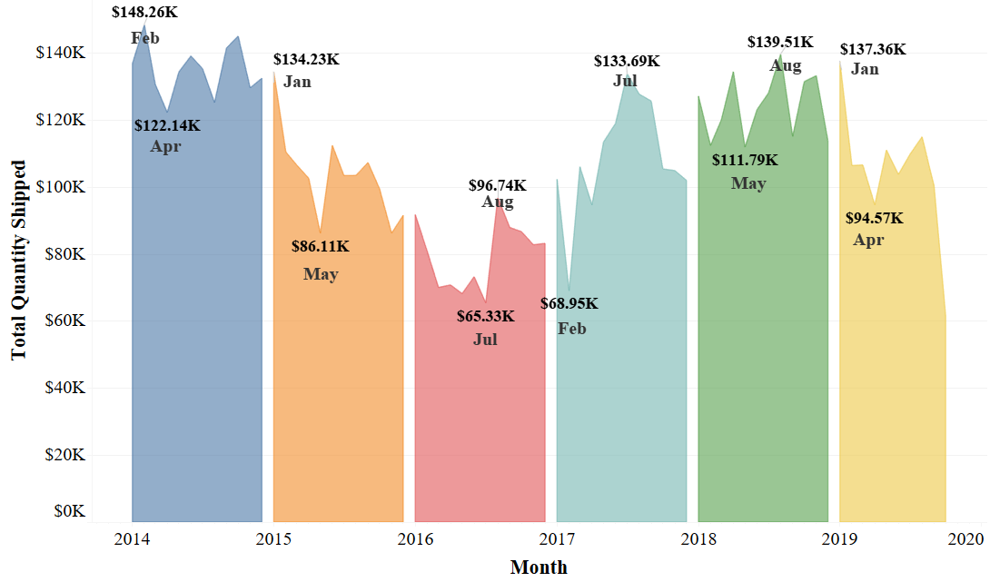
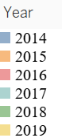
Quantity shipped each month
Lowest: July 2016
Highest: February 2014
After Spring: Profit increased except for 2019
After Summer: Profit declined except for 2017
Analysis
Overview
Data
Business
Cleaning
Notes:
This is the trends for each month in each year. The marked months are the highest and lowest quantity ordered in a particular year. In the overall the July 2016 has marked the lowest quantity month for the past 6 years and feb 2014 has marked the highest.

